Slide 1


Aleksei Trubin
22 November 2023

Slide 2

Outline
Executive Summary
Introduction
Methodology
Results
Conclusion
Appendix

Slide 3
Executive Summary
Summary of methodologies
Data Collection through API
Data Collection with Web Scraping
Data Wrangling
Exploratory Data Analysis with SQL
Exploratory Data Analysis with Data Visualization
Interactive Visual Analytics with Folium
Machine Learning Prediction
Summary of all results
Exploratory Data Analysis result
Interactive analytics in screenshots
Predictive Analytics result

Slide 4
Introduction
Project background and context
The project aims to develop a machine learning pipeline capable of predicting the successful landing of SpaceX's Falcon 9 rocket's first stage. SpaceX, known for its cost-effective space missions, offers Falcon 9 launches at approximately $62 million on its website, significantly lower than other providers who charge upwards of $165 million. This price difference is largely attributed to SpaceX's ability to reuse the first stage of the rocket. By accurately forecasting the landing outcomes, this project could provide crucial cost estimation insights, especially for alternate companies competing with SpaceX in bidding for rocket launches.
Problems you want to find answers
Which variables are crucial for a rocket's successful touchdown?
How do the different variables interplay to affect the success rate of landing?
What are the essential operational conditions for a consistent and successful rocket landing strategy?

Slide 5

Section 1

Slide 6
Methodology
Executive Summary
Data collection methodology:
DatafromSpaceXwasobtainedfrom2sources:
SpaceXAPI(https://api.spacexdata.com/v4/rockets/)
WebScraping (https://en.wikipedia.org/wiki/List_of_Falcon/_9/_and_Falcon_Heavy_launches)
Perform data wrangling
The gathered data was enhanced by developing a label for the landing outcome, which was derived from the post-mission results following a comprehensive summary and analysis of the features.

Slide 7
Methodology
Executive Summary
Perform exploratory data analysis (EDA) using visualization and SQL
Perform interactive visual analytics using Folium and Plotly Dash
Perform predictive analysis using classification models
The collected data was standardized, segregated into training and test datasets, and then assessed using four distinct classification models. The performance of each model was gauged by experimenting with various parameter configurations.

Slide 8
Data Collection
Describe how data sets were collected.
Datasets were collected from SpaceX API (https://api.spacexdata.com/v4/rockets/) and from Wikipedia (https://en.wikipedia.org/wiki/List_of_Falcon/_9/_and_Falcon_Heavy_launches), using web scraping technics.

Slide 9
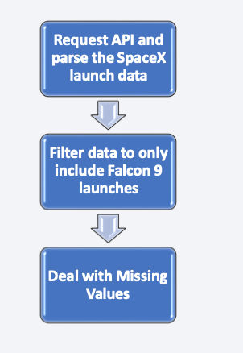
Data Collection – SpaceX API
SpaceX offers a public API from where data can be obtained and then used;
This API was used according to the flowchart beside and then data is persisted.
Source code:
https://github.com/bassballs/Data-Science-and-Machine-Learning-Capstone-Project/blob/main/Data%20Collection%20API.ipynb

Slide 10
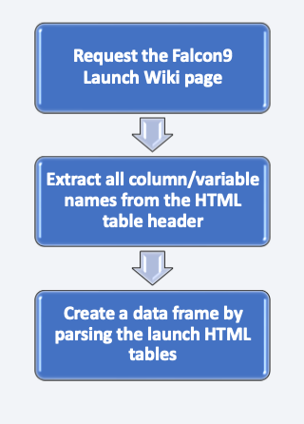
Data Collection - Scraping
• Data from SpaceX launches can also be obtained from Wikipedia;
• Data are downloaded from Wikipedia according to the flowchart and then persisted.
• Source code: https://github.com/bassballs/Data-Science-and-Machine-Learning-Capstone-Project/blob/main/Data%20Collection%20with%20Web%20Scraping.ipynb

Slide 11
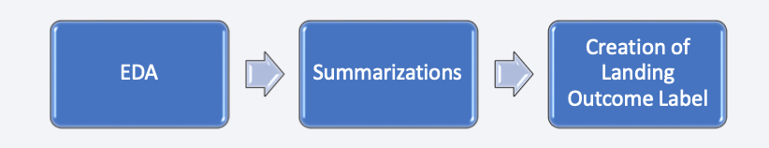
Data Wrangling
Initially some Exploratory Data Analysis (EDA) was performed on the dataset.
Then the summary launches per site, occurrences of each orbit and occurrences of mission outcome per orbit type were calculated.
Finally, the landing outcome label was created from Outcome column.
Source code: https://github.com/bassballs/Data-Science-and-Machine-Learning-Capstone-Project/blob/main/Data%20Wrangling.ipynb

Slide 12
EDA with Data Visualization
The following SQL queries were performed:
Names of the unique launch sites in the space mission;
Top 5 launch sites whose name begins with the string 'CCA’;
Total pay load mass carried by boosters launched by NASA (CRS);
Average payload mass carried by booster version F9 v1.1;
Date when the first successful landing outcome in ground pad was achieved;
Names of the boosters which have success in drone ship and have payload mass between 4000 and 6000 kg;
Total number of successful and failure mission outcomes;
Names of the booster versions which have carried the maximum payload mass;
Failed landing out comes in droneship, their booster versions, and launch site names for in year 2015; and
Rank of the count of landing outcomes (such as Failure (droneship) or Success (ground pad)) between the date 2010-06-04 and 2017-03-20.
Source code: https://github.com/bassballs/Data-Science-and-Machine-Learning-Capstone-Project/blob/main/EDA%20with%20Data%20Visualization.ipynb

Slide 13
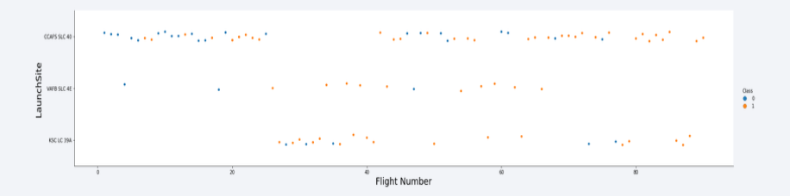
EDA with SQL
To explore data, scatterplots and bar plots were used to visualize the relationship between pair of features:
Payload Mass X Flight Number, Launch Site X Flight Number, Launch Site X Payload Mass, Orbit and Flight Number, Payload and Orbit
Source code: https://github.com/bassballs/Data-Science-and-Machine-Learning-Capstone-Project/blob/main/EDA%20with%20SQL.ipynb

Slide 14
Build an Interactive Map with Folium
Markers, circles, lines and marker clusters were used with Folium Maps
Markers indicate points like launch sites;
Circles indicate highlighted areas around specific coordinates, like NASA Johnson Space Center;
Marker clusters indicates groups of events in each coordinate, like launches in a launch site; and
Lines are used to indicate distances between two coordinates.
Source code: https://github.com/bassballs/Data-Science-and-Machine-Learning-Capstone-Project/blob/main/Interactive%20Visual%20Analytics%20with%20Folium.ipynb

Slide 15
Build a Dashboard with Plotly Dash
We built an interactive dashboard with Plotly dash
We plotted pie charts showing the total launches by a certain sites
We plotted scatter graph showing the relationship with Outcome and Payload Mass (Kg) for the different booster version.
The link to the notebook is https://github.com/bassballs/Data-Science-and-Machine-Learning-Capstone-Project/blob/main/app.py

Slide 16
Predictive Analysis (Classification)
We loaded the data using numpy and pandas, transformed the data, split our data into training and testing.
We built different machine learning models and tune different hyperparameters using GridSearchCV.
We used accuracy as the metric for our model, improved the model using feature engineering and algorithm tuning.
We found the best performing classification model.
The link to the notebook is https://github.com/bassballs/Data-Science-and-Machine-Learning-Capstone-Project/blob/main/Machine%20Learning%20Prediction.ipynb

Slide 17
Results
Exploratory data analysis results:
Space X uses 4 different launch sites;
The first launches were done to Space X itself and NASA;
The average payload of F9 v1.1 booster is 2,928 kg;
The first success landing outcome happened in 2015 fiver year after the first launch;
Many Falcon 9 booster versions were successful at landing in drone ships having payload above the average;
Almost 100% of mission outcomes were successful;
Two booster versions failed at landing in drone ships in 2015: F9 v1.1 B1012 and F9 v1.1 B1015;
The number of landing outcomes became as better as years passed.

Slide 18
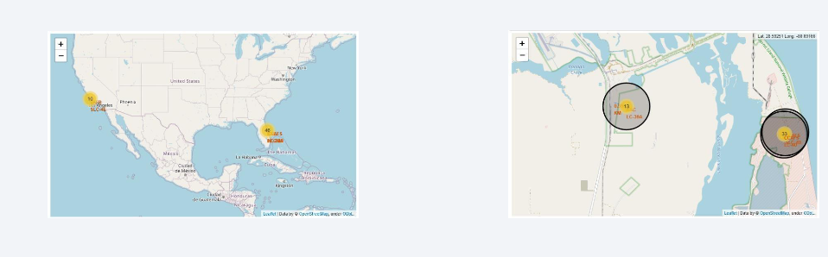
Results
Interactive analytics revealed that launch sites are typically situated in safe locations, such as near the sea, and are surrounded by robust logistical infrastructure. Additionally, the majority of launches tend to occur at launch sites on the east coast.

Slide 19

Section 2

Slide 20

Flight Number vs. Launch Site
From the plot, we found that the larger the flight amount at a launch site, the greater the success rate at a launch site.

Slide 21


Payload vs. Launch Site
Payload vs. Launch Site

Slide 22

Success Rate vs. Orbit Type
From the plot, we can see that ES-L1, GEO, HEO, SSO, VLEO had the most success rate.

Slide 23

Flight Number vs. Orbit Type
The plot below shows the Flight Number vs. Orbit type. We observe that in the LEO orbit, success is related to the number of flights whereas in the GTO orbit, there is no relationship between flight number and the orbit.

Slide 24

Payload vs. Orbit Type
We can observe that with heavy payloads, the successful landing are more for PO, LEO and ISS orbits.

Slide 25

Launch Success Yearly Trend
From the plot, we can observe that success rate since 2013 kept on increasing till 2020.

Slide 26

All Launch Site Names
We used the key word DISTINCT to show only unique launch sites from the SpaceX data.

Slide 27

Launch Site Names Begin with 'CCA'
We used the query above to display 5 records where launch sites begin with `CCA`

Slide 28

Total Payload Mass
We calculated the total payload carried by boosters from NASA as 45596 using the query below

Slide 29

Average Payload Mass by F9 v1.1
We calculated the average payload mass carried by booster version F9 v1.1 as 2928.4

Slide 30

First Successful Ground Landing Date
We observed that the dates of the first successful landing outcome on ground pad was 22nd December 2015

Slide 31

Successful Drone Ship Landing with Payload between 4000 and 6000
We used the WHERE clause to filter for boosters which have successfully landed on drone ship and applied the AND condition to determine successful landing with payload mass greater than 4000 but less than 6000

Slide 32

Total Number of Successful and Failure Mission Outcomes
We used wildcard like ‘%’ to filter for WHERE MissionOutcome was a success or a failure.

Slide 33

Boosters Carried Maximum Payload
We determined the booster that have carried the maximum payload using a subquery in the WHERE clause and the MAX() function.

Slide 34

2015 Launch Records
We used a combinations of the WHERE clause, LIKE, AND, and BETWEEN conditions to filter for failed landing outcomes in drone ship, their booster versions, and launch site names for year 2015.

Slide 35

Rank Landing Outcomes Between 2010-06-04 and 2017-03-20
We selected Landing outcomes and the COUNT of landing outcomes from the data and used the WHERE clause to filter for landing outcomes BETWEEN 2010-06-04 to 2010-03-20.
We applied the GROUP BY clause to group the landing outcomes and the ORDER BY clause to order the grouped landing outcome in descending order.

Slide 36

Section 3

Slide 37

All launch sites global map markers

Slide 38

Markers showing launch sites with color labels

Slide 39

Launch Site distance to landmarks

Slide 40

Section 4

Slide 41

Pie chart showing the success percentage achieved by each launch site

Slide 42

Pie chart showing the Launch site with the highest launch success ratio

Slide 43

Scatter plot of Payload vs Launch Outcome for all sites, with different payload selected in the range slider

Slide 44

Section 5

Slide 45

Classification Accuracy
The Decision Tree classifier has emerged as the model with the highest classification accuracy.

Slide 46

Confusion Matrix
The confusion matrix of the Decision Tree classifier indicates its capability to differentiate between the various classes. However, the primary issue lies in the occurrence of false positives, where the classifier incorrectly labels unsuccessful landings as successful.

Slide 47
Conclusions
A higher number of flights conducted at a launch site correlates with an increased success rate at that site.
The overall success rate of launches has been on an upward trend from 2013 through 2020.
The orbits ES-L1, GEO, HEO, SSO, and VLEO have recorded the highest success rates.
KSC LC-39A outperformed all other launch sites in terms of successful launches.
For this particular task, the Decision Tree classifier emerged as the most effective machine learning algorithm.

Slide 48


